Slide 1
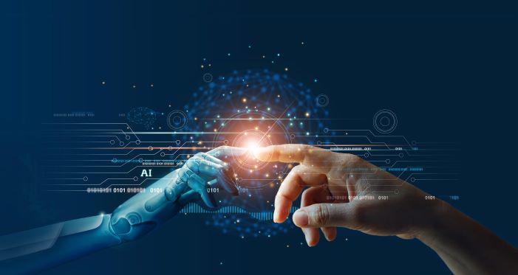

Slide 2


Artificial
DREAMS
intelligence
English Exchange with NTT

Slide 3
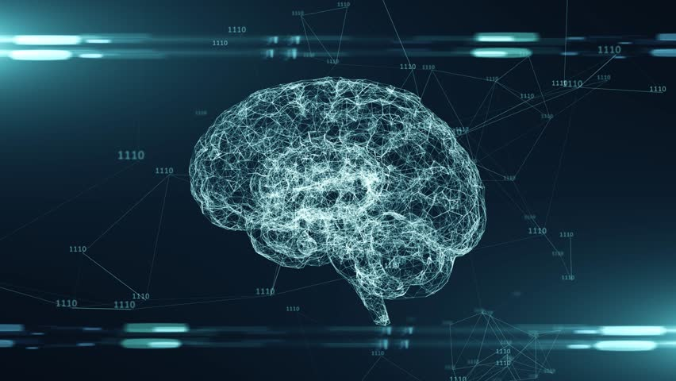
WHAT IS
AI​​?

Slide 4
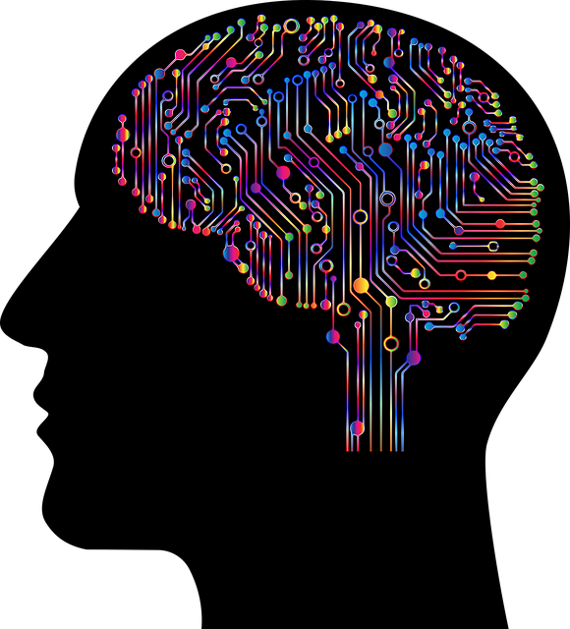
Advantages of
Artificial
Intelligence

Slide 5
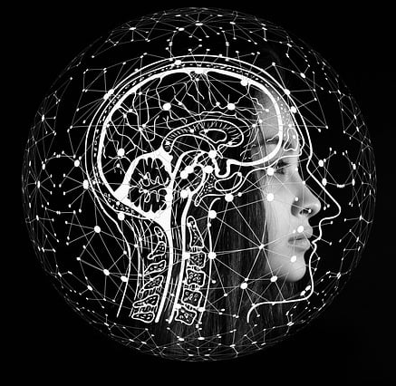
Advantages of AI
01
Reduction in human error
Perform repetitive jobs
06
02
Zero risks
Daily applications
07
03
24x7 availability
Faster decision-making
08
04
Digital assistance
Pattern identification
09
05
Unbiased dicisions

Slide 6
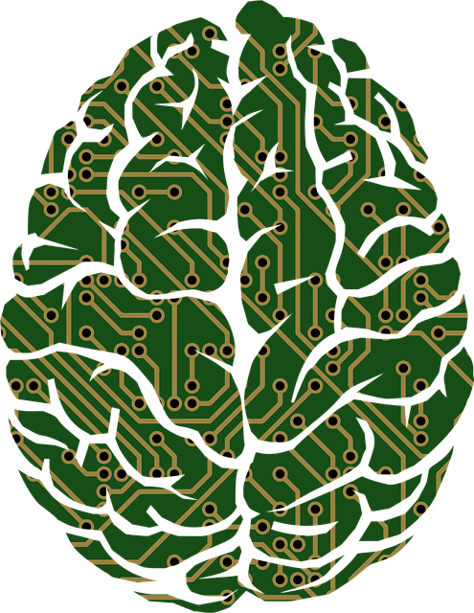
Disadvantages of AI
High costs
01
05
ethics
No creativity
02
06
emotionaless
unemployment
03
07
No improvement
04
Make human lazy

Slide 7
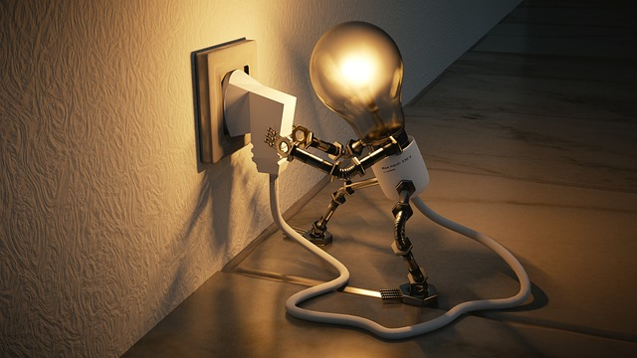
CONCLUSION

